Slide 1

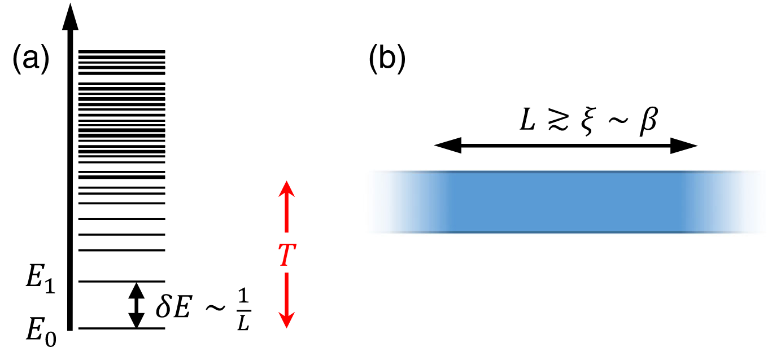
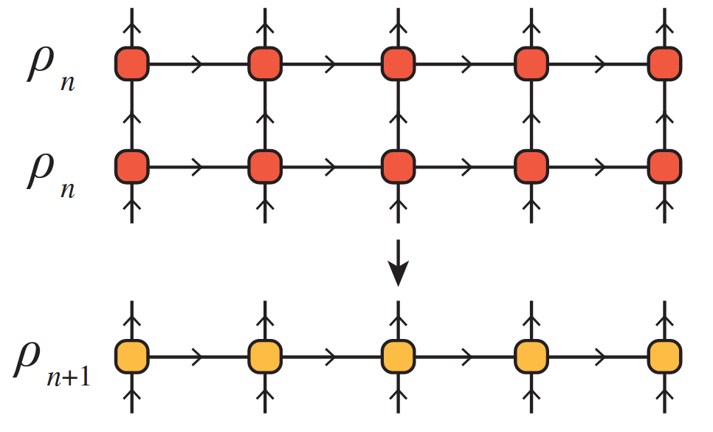
The Exponential Tensor Network Renormalization Group (XTRG)
A Simulation of the XY-Model
PAWLIK Matthias, ALIVERTI Damiano
Tensor Networks Course Final Presentation – 23.07.2025
Notes:
Matthias

Slide 2
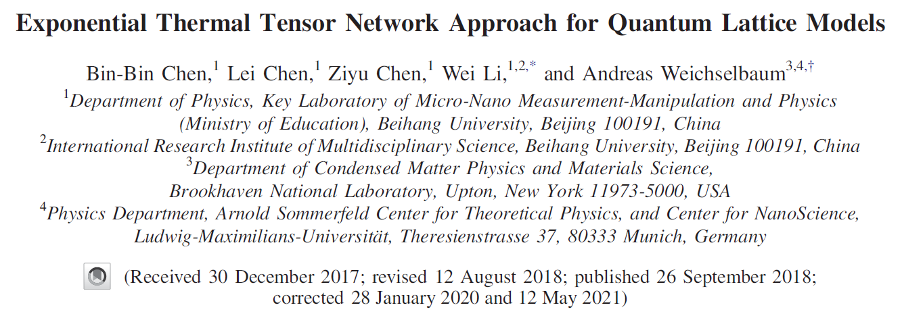
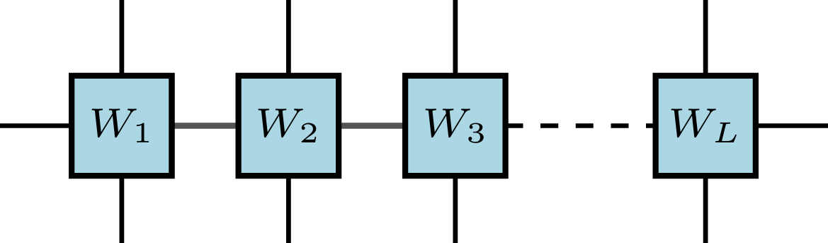
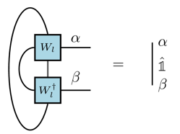
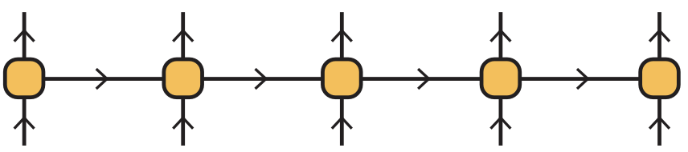
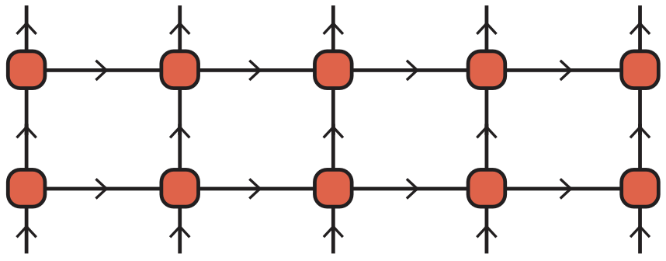
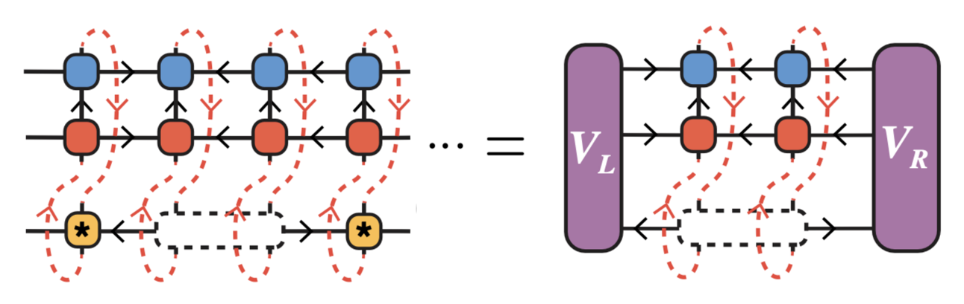
Outline of the Talk
[1]
I. Motivation & Key Ideas of XTRG
III. Implementation of the XTRG Algorithm
trace_mpo
add_mpo
tensor_svd
Tensor manipulations of MPOs
left_canonicalmpo!
square_mpo
normalize_mpo!
Canonicalization of MPOs
DMRG-type sweeping
II. Global Structure of the XTRG Algorithm
XTRG_update
Linear initialization
XTRG_algorithm
Contraction of MPOs
IV. Simulation of the 1D XY-Model
Variational XTRG update
[1] Chen, B.-B., Chen, L., Chen, Z., Li, W., & Weichselbaum, A. (2018)
Notes:
Matthias

Slide 3
Motivation & Key Ideas of XTRG
Part I / IV
Notes:
Damiano

Slide 4
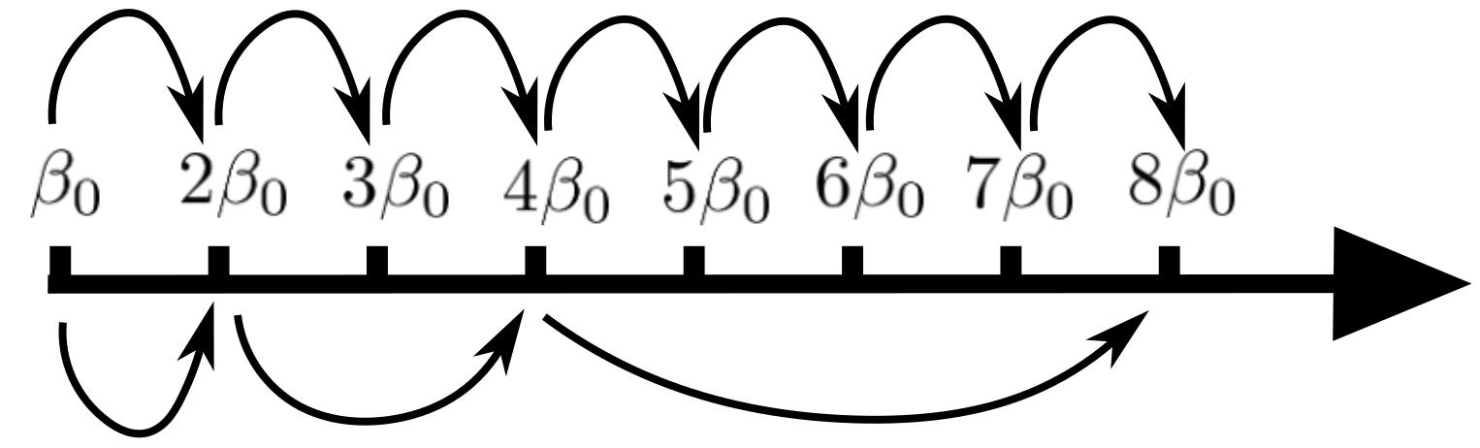
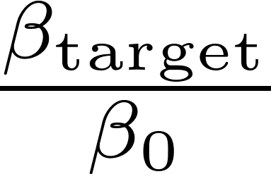
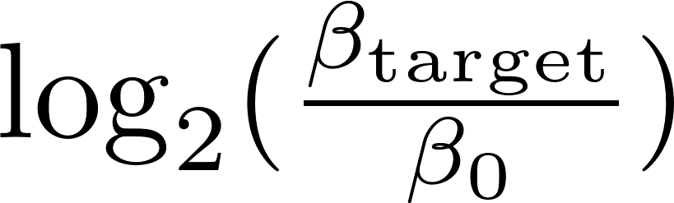

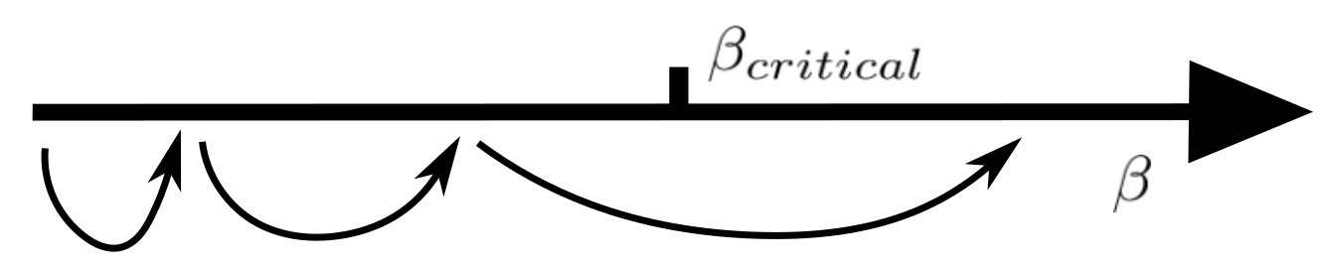
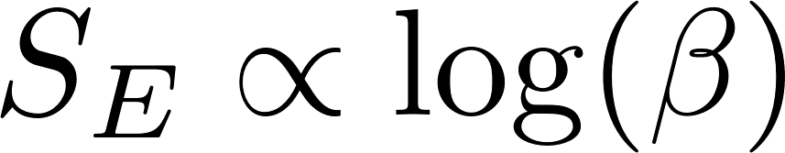
4
Motivation & Key Ideas
Exponential reduction of # steps
Imaginary time evolution:
steps
XTRG algorithm:
steps
Avoid critical points
XTRG is in principle able to jump over phase transitions in space, which is where converged computations get costly
Scaling of entanglement
For many 1D models, thermal state entanglement scales as .
It is often expected that changes in entanglement reflect transitions between physical regimes. One should then use a logarithmic scale for to see sizable effects.
Notes:
Damiano

Slide 5
5
Global Structure of the XTRG Algorithm
Part II / IV
Notes:
Damiano

Slide 6
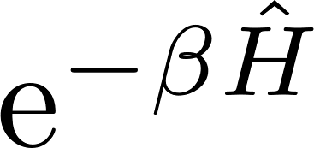
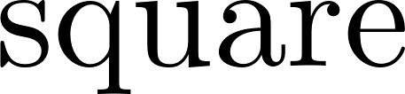
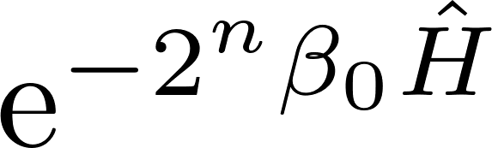
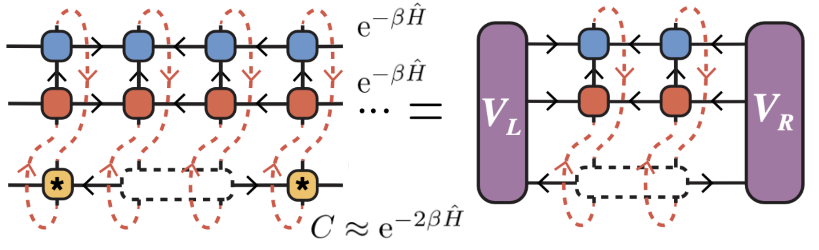
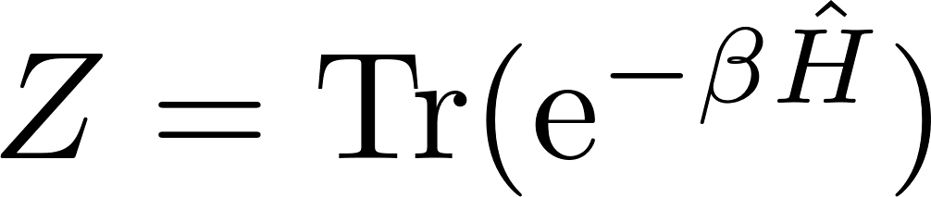
6
The XTRG Algorithm
Main idea
Compute unnormalized thermal states of 1D chain Hamiltonians on an exponential temperature scale by iterative self-contraction of the state
Represent as an MPO, compute its square with tensor network techniques, and truncate virtual bond dimension with a variational method
XTRG Algorithm
We will use the method on a 1D XY chain of L = 10 sites,
Model
Goal
Compute the partition function for exponentially discretized and compare with analytical result
Notes:
Damiano

Slide 7
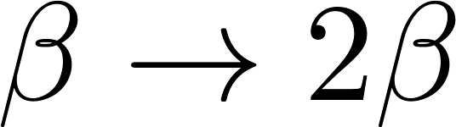
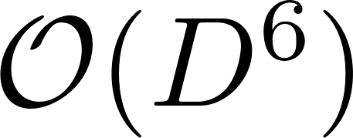
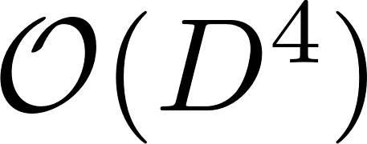

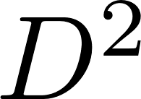
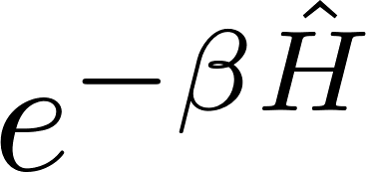
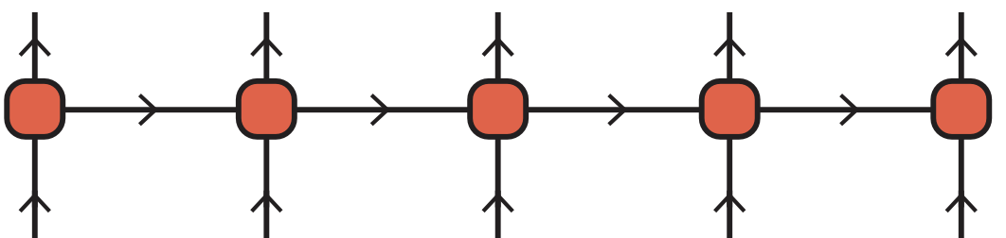
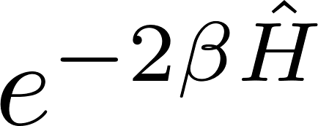
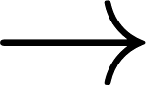


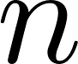
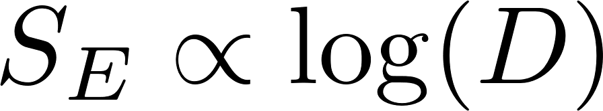

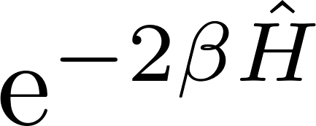

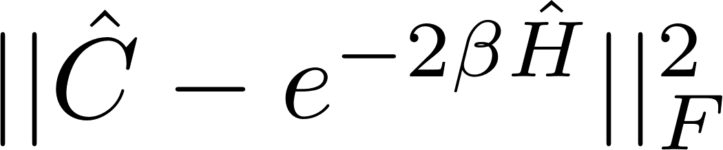
7
MPOs and Truncations
MPO representation
Using tensor network representation helps to visualize the applied truncation method. clearer. The thermal state will be represented as an MPO.
Compression by truncation
One XTRG temperature update:
SVD versus variational update
When lowering the temperature, , the bond dimension would increase exponentially in , i.e., superexponentially in . But the slow entanglement growth along with suggest truncating bond dimension as .
Truncation and optimization scheme
will be approximated by a low- MPO that minimizes
Notes:
Matthias

Slide 8
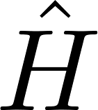

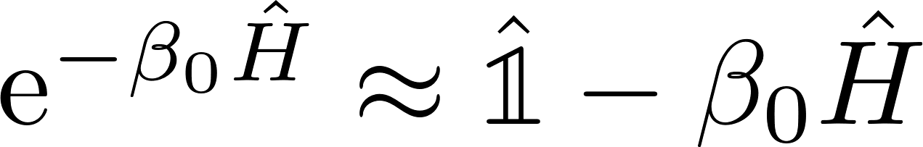
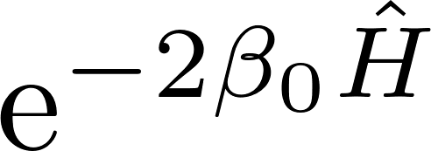
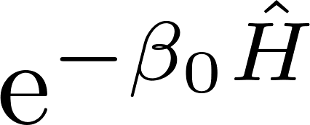
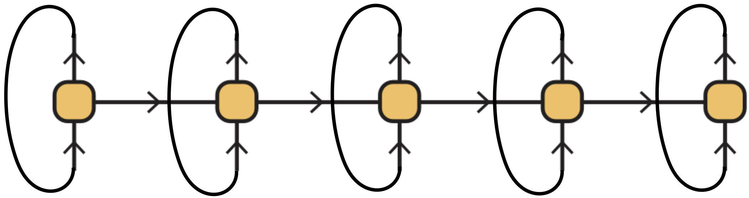
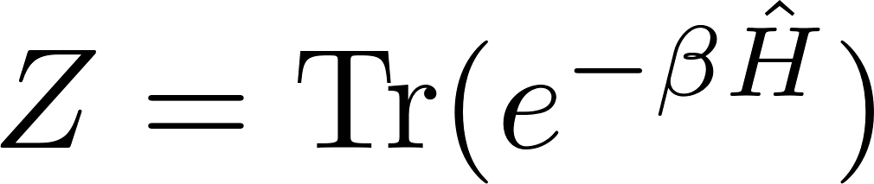

8
Algorithm Structure
Goal
Recall: we want to compute the MPO of for many inverse temperatures
1. Hamiltonian: get an MPO representation of the model Hamiltonian
2. Linear high-temperature initialization: choose ‘small’ and approximate
3. XTRG updates : compute and truncate the MPO for by contracting
the MPO for with itself, . Iterate the XTRG update, while storing
as well as any other data of interest (e.g. singular values at the bonds)
Main steps
,
and
Notes:
Matthias

Slide 9
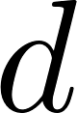
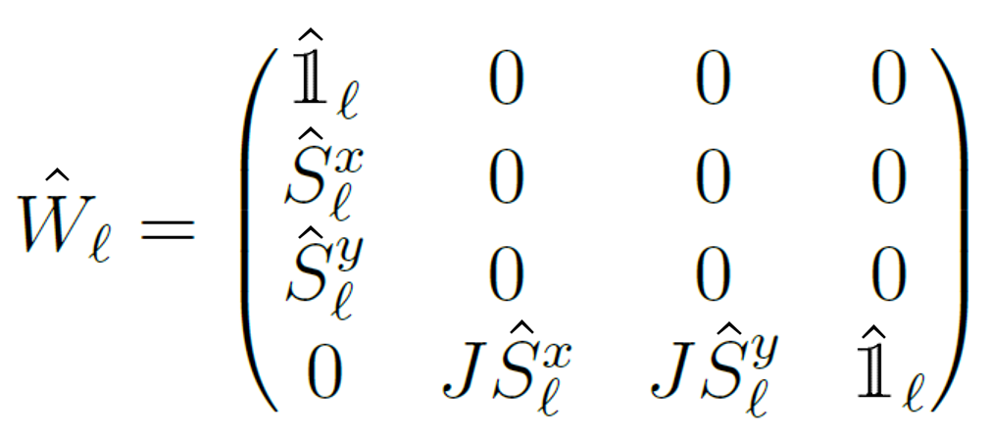
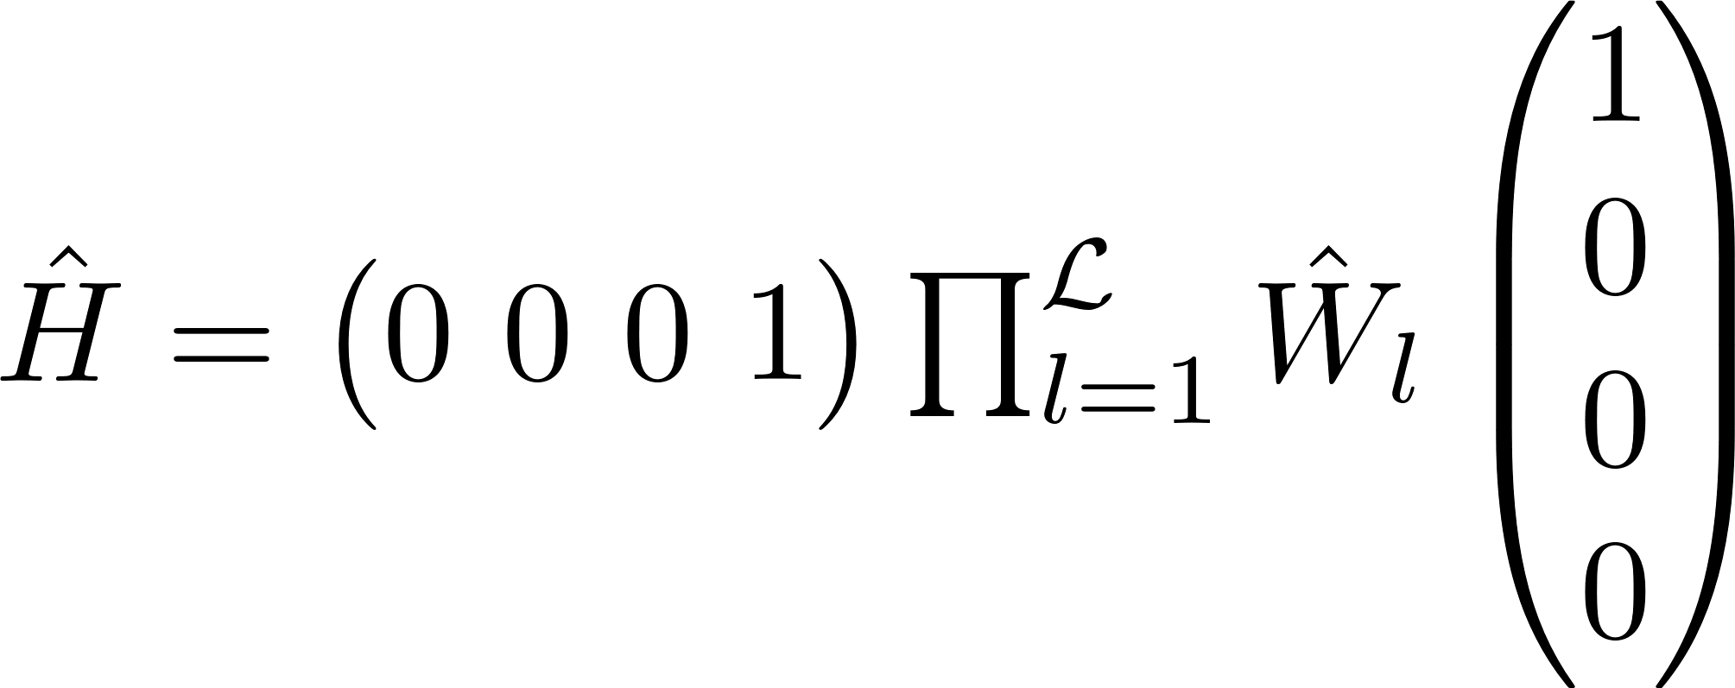
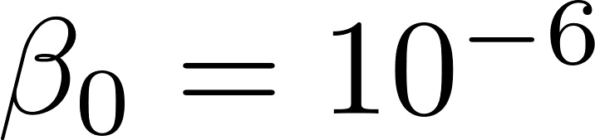
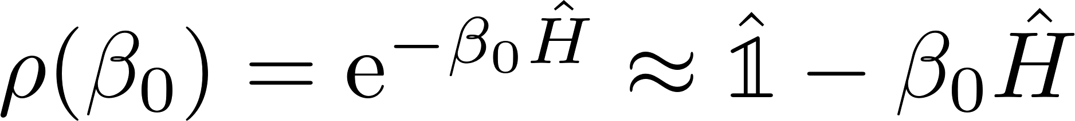

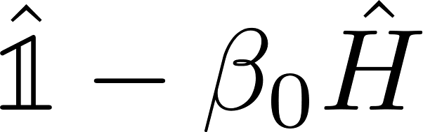

9
Hamiltonian and Linear Initialization
XY-Model
MPO representation
with
such that
Linear initialization
We approximate the (unnormalized) thermal state at high temperature, , as
Using the fact that and can be represented by MPOs with bond dimension 4 and 1, respectively, we represent as an MPO with bond dimension
Notes:
Matthias

Slide 10
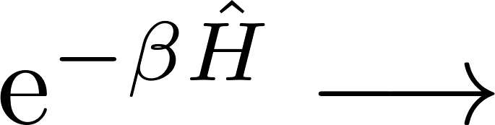

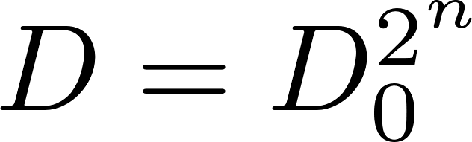
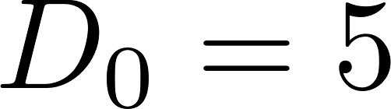

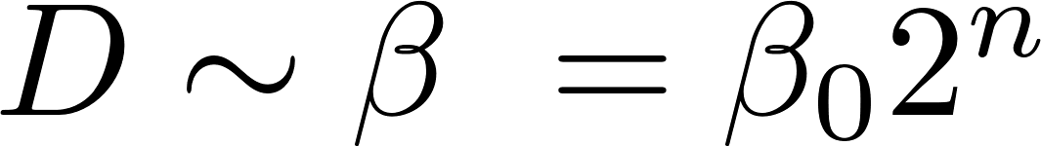
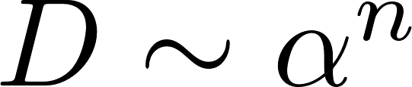
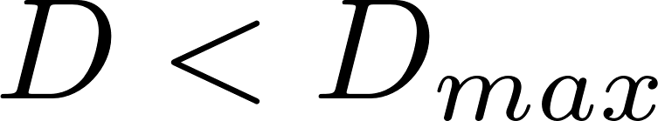
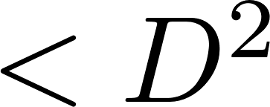
10
The XTRG Update
Input data
MPO for
Goal
Get MPO for , obtained as an approximation of the MPO for the exact square
Efficiency condition
If we keep the exact square MPO the bond dimension grows as , with for the XY-Model and # updates. But should be enough!
In practice, we allow for exponential growth, , with a threshold,
Main problem
How to approximate with an MPO of bond dimension ?
Notes:
Damiano

Slide 11

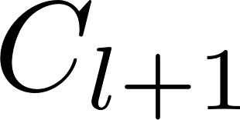












11
The Variational Two-Site Update
scaling factor
bond dimension
We approximate by minimizing
over operators with appropriately enlarged bond dimension
Ansatz
We optimize one pair of tensors at a time, as for two-site DMRG
Minimization formula for update of the contraction !
Left and right environments need to be computed iteratively
Do an SVD to separate from while keeping MPO site-canonical
Proceed with sites
Sweep back and forth along the chain until convergence
= open leg
Notes:
Damiano

Slide 12
12
Implementation of the XTRG Algorithm
Part III / IV

Slide 13


13
Canonicalization of Matrix Product Operators (MPOs)
[2]
As for MPSs, MPOs can be brought into canonical forms
Canonical forms of MPOs
The above MPO is said to be in left-canonical form iff the single-site tensors have the following isometry property:
Similarly, there exist left- and site-canonical forms of MPOs. Like for MPSs, a given MPO can be transformed into a canonical form, e.g., by successive QR or SVD decompositions.
Connection with MPSs
MPOs in canonical form are structured such that merging physical legs yields canonical MPS!
[2] Parker, D. E., Cao, X., & Zaletel, M. P. (2020)
Notes:
Damiano

Slide 14




14
leftcanonicalmpo!
Brings an MPO into left-canonical form by treating it as an MPS (with merged physical legs).
Similarly, one could define the update reversely using
For completeness we also implemented
What does it do?
Why needed?
Canonical forms simplify the minimization equations during the XTRG update
Notes:
Damiano

Slide 15


15
add_mpo
What does it do?
Adds two operators in MPO representation
Why needed?
We use this for linear initialization,
Notes:
Damiano

Slide 16



16
square_mpo
What does it do?
Squares an operator in MPO representation
Provides an initial guess at each XTRG update to start the compression through variational optimization
Why needed?
Notes:
Matthias

Slide 17





17
updateLeftEnv
What does it do?
Slight modification of
Why needed?
Get environment tensors needed in the update of . All left environments are computed in the beginning of the optimization process, and are then iteratively updated by performing one
contraction before the update of the next two sites.
Notes:
Matthias

Slide 18






18
normalize_mpo!
What does it do?
Normalizes an operator in MPO representation with respect to the Frobenius norm
Why needed?
We want to keep track of the convergence of the variational two-site update which minimizes
Notes:
Matthias

Slide 19




19
trace_mpo
What does it do?
Computes the trace of an operator in MPO form
Why needed?
Computation of the partition function
Checked the functionality of all methods with unit tests!
Notes:
Matthias (switch to unit tests in notebook)

Slide 20


20
XTRG_update
What does it do?
This function combines all previous methods in a DMRG-type variational two-site update method
In essence, it takes an input MPO
and returns its square, truncated and optimized after several sweeps.
XTRG_algorithm
What does it do?
This function iteratively calls and returns tuples ( ), as well as the singular values on the bonds.
Notes:
Matthias

Slide 21








21
Flowchart for
XTRG_update
1) Increase bond dimension
7) Compute partition function
2) Initialize MPO as either
exact square or
6) Check convergence
3) canonicalize MPO
4) Prepare environments for sweeping
5) Left-to-right sweeping (back direction analogously)
Notes:
Matthias (switch to output console in notebook)

Slide 22
22
Simulation of the 1D XY-Model
Part IV / IV
Notes:
Damiano

Slide 23


23
1D XY-Model: Analytics
The Hamiltonian
Mapping to spinless fermions
A Jordan-Wigner transformation to a system of spinless fermionic modes yields the isospectral fermionic tight-binding Hamiltonian
diagonalize
with single-particle eigenvalues/dispersion relation
Partition function
The partition function factorizes:
Notes:
Damiano

Slide 24











24
Numerical versus Analytical Partition Function
Method and parameters
We ran our XTRG algorithm code for sites, with initial , for up to 27 steps, i.e., up to and computed the partition function for all ‘s
Bond dimension scaling:
Max bond dimension:
# sweeps along chain:
Initialization: outperformed
Norm error tolerance:
Technical details
Our values agree well with the analytical prediction.
The tolerance check was passed up to the 20th step - afterwards convergence checks become too costly.
Within the 28th step, the value of the partition function exceeds the maximal representable float in double precision
Results
Notes:
Matthias (switch to partition function graph in notebook)

Slide 25


Numerical versus Analytical Partition Function
Relative error
is vanishingly small and, as it happens, positive for all ‘s
Notes:
Matthias

Slide 26


26
Smooth Behavior of Singular Values
Where we do SVD?
Each two-site update yields an optimized value for the contraction , but not the two single tensors. These must be separated after the optimization, using SVD.
One (JvD) would expect these singular values to change smoothly with . We checked: yes!
Also, some singular values become degenerate when reaching the ground state
Singular values
By extrapolating singular values of from those of previous ‘s, one could try to improve the initialization of
at the XTRG update.
Why interesting?
Notes:
Damiano (switch to singular value plots in notebook)

Slide 27
27
The Low-Temperature Bottleneck
Challenge
The evaluation of becomes numerically intractable when the bond dimension of increases exponentially in the low temperature regime.
Qualitative estimate
Low bond dimensions should suffice at least as long as is close to identity, i.e.,
We could push the numerics up to 27 steps Order of runtime = 1 min
However, the check of convergence in the Frobenius norm becomes too costly at around step 23, but the results still coincide with the analytical prediction.
Observations
Open Question
How can we verify convergence of the XTRG update with respect to the previous step in the low-temperature regime? This would be required to assess the quality of computation results for models where no analytical solution is known.
Notes:
Damiano

Slide 28
28
Summary and Conclusions
We implemented the XTRG algorithm ( ) to compute the partition function of the 1D XY-Model at various inverse temperatures
The MPO squaring implementation resembles two-site DMRG, with different optimization rules
The values of we computed agree with analytics
We found that the singular values at the bonds evolve smoothly as a function of
Main open question: general conditions under which the XTRG algorithm works? How to overcome the low-temperature bottleneck to check convergence?
Thanks!
Notes:
Matthias

Slide 29
29
Literature References
[1] Chen, B.-B., Chen, L., Chen, Z., Li, W., & Weichselbaum, A. (2018). Exponential Thermal Tensor Network Approach for Quantum Lattice Models. Physical Review X, 8(3), 031082. https://doi.org/10.1103/PhysRevX.8.031082
[2] Parker, D. E., Cao, X., & Zaletel, M. P. (2020). Local matrix product operators: Canonical form, compression, and control theory. Physical Review B, 102(3), 035147. https://doi.org/10.1103/PhysRevB.102.035147
Notes:
Matthias

